Slide 1
L.E.O.S.A & I.R.O.C.C. Spring 2023 Updates HB 4667 Response
The Federal Law Enforcement Officer Safety Act
and the
Illinois Retired Officer Concealed Carry Program

Slide 2
LEOSA - 18 U.S.C. 926C
The purpose of the ``Law Enforcement Officers Safety Act of 2003,'' is to authorize qualified off-duty law enforcement officers and qualified retired law enforcement officers carrying photographic identification issued by a governmental agency for which the individual is, or was, employed as a law enforcement officer, to carry a concealed firearm that has been shipped or transported in interstate or foreign commerce. This bill establishes national measures of uniformity and consistency to permit law enforcement officers to respond immediately to a crime when off duty, as well as to protect officers and their families from vindictive criminals. – Senate Judiciary Committee, 2004
Law enforcement officers are never ``off-duty‘’. They are dedicated public servants trained to uphold the law and keep the peace. To enable law enforcement officers nationwide to be prepared to answer a call to duty no matter where, when, or in what form it comes. Sen. Leahy, July 7, 2004

Slide 3
LEOSA - Text
§ 926C. Carrying of concealed firearms by qualified retired law enforcement officers
(a) Notwithstanding any other provision of the law of any State or any political subdivision thereof, an individual who is a qualified retired law enforcement officer and who is carrying the identification required by subsection (d) may carry a concealed firearm that has been shipped or transported in interstate or foreign commerce, subject to subsection (b).
(b) This section shall not be construed to supersede or limit the laws of any State that—
(1) permit private persons or entities to prohibit or restrict the possession of concealed firearms on their property; or
(2) prohibit or restrict the possession of firearms on any State or local government property, installation, building, base, or park.
(c) As used in this section, the term “qualified retired law enforcement officer” means an individual who—
(1) separated from service in good standing from service with a public agency as a law enforcement officer;
(2) before such separation, was authorized by law to engage in or supervise the prevention, detection, investigation, or prosecution of, or the incarceration of any person for, any violation of law, and had statutory powers of arrest or apprehension under section 807(b) of title 10, United States Code (article 7(b) of the Uniform Code of Military Justice);
(3) (A) before such separation, served as a law enforcement officer for an aggregate of 10 years or more; or (B) separated from service with such agency, after completing any applicable probationary period of such service, due to a service-connected disability, as determined by such agency;
(4) during the most recent 12-month period, has met, at the expense of the individual, the standards for qualification in firearms training for active law enforcement officers, as determined by the former agency of the individual, the State in which the individual resides or, if the State has not established such standards, either a law enforcement agency within the State in which the individual resides or the standards used by a certified firearms instructor that is qualified to conduct a firearms qualification test for active duty officers within that State;

Slide 4
LEOSA – Text (cont.)
(5)(A) has not been officially found by a qualified medical professional employed by the agency to be unqualified for reasons relating to mental health and as a result of this finding will not be issued the photographic identification as described in subsection (d)(1); or (B) has not agreed with the agency from which the individual is separating from service in which that individual acknowledges he or she is not qualified under this section for reasons relating to mental health and for those reasons will not receive or accept the photographic identification as described in subsection (d)(1);
(6) is not under the influence of alcohol or another intoxicating or hallucinatory drug or substance; and
(7) is not prohibited by Federal law from receiving a firearm.
(d) The identification required by this subsection is—
(1) a photographic identification issued by the agency from which the individual separated from service as a law enforcement officer that identifies the person as having been employed as a police officer or law enforcement officer and indicates that the individual has, not less recently than one year before the date the individual is carrying the concealed firearm, been tested or otherwise found by the agency to meet the active duty standards for qualification in firearms training as established by the agency to carry a firearm of the same type as the concealed firearm; or
(2)(A) a photographic identification issued by the agency from which the individual separated from service as a law enforcement officer that identifies the person as having been employed as a police officer or law enforcement officer; and (B) a certification issued by the State in which the individual resides or by a certified firearms instructor that is qualified to conduct a firearms qualification test for active duty officers within that State that indicates that the individual has, not less than 1 year before the date the individual is carrying the concealed firearm, been tested or otherwise found by the State or a certified firearms instructor that is qualified to conduct a firearms qualification test for active duty officers within that State to have met—
i) the active duty standards for qualification in firearms training, as established by the State, to carry a firearm of the same type as the concealed firearm; or
(ii) if the State has not established such standards, standards set by any law enforcement agency within that State to carry a firearm of the same type as the concealed firearm.

Slide 5
LEOSA – Text (cont.)
(e) As used in this section—
(1) the term “firearm”—
(A) except as provided in this paragraph, has the same meaning as in section 921 of this title [18 USCS § 921];
(B) includes ammunition not expressly prohibited by Federal law or subject to the provisions of the National Firearms Act [26 USCS §§ 5801 et seq.]; and
(C) does not include—
(i) any machinegun (as defined in section 5845 of the National Firearms Act [26 USCS § 5845]);
(ii) any firearm silencer (as defined in section 921 of this title [18 USCS § 921]); and
(iii) any destructive device (as defined in section 921 of this title [18 USCS § 921]); and
(2) the term “service with a public agency as a law enforcement officer” includes service as a law enforcement officer of the Amtrak Police Department, service as a law enforcement officer of the Federal Reserve, or service as a law enforcement or police officer of the executive branch of the Federal Government.

Slide 6
LEOSA – Eligibility: 7 Elements
1. Separated from service
as a law enforcement officer
from a public agency
in good standing
2. Before separation:
Was authorized by law to engage in or supervise the:
prevention
detection
investigation
Prosecution, or
Incarceration of any person for, any violation of the law
Had statutory powers of arrest
Has met the firearm qualification for active officers within the last year
No issues of substance abuse
3. With at least 10 years of service (or a disability)

Slide 7
LEOSA – Eligibility (cont.)
4. Has met the firearm qualification for active officers within the last year
5. No history of mental health issues
6. Not under the influence of alcohol or other controlled substances
7. Not otherwise prohibited from carrying a firearm under federal laws

Slide 8
LEOSA – Prerequisites: ID Card
Must be a photo I.D.
Must be issued from the agency where the officer separated from service as a law enforcement officer
Must identify the individual as having been employed as a police officer or law enforcement officer

Slide 9
LEOSA – Prerequisites: Firearm Card
4. Individuals must also have a certification card indicating that they met the firearm qualification for active officers within the last 12 months.
Must be issued by:
a. Former employer,
b. The State, or
c. A certified firearms instructor authorized to conduct annual firearm requalification

Slide 10
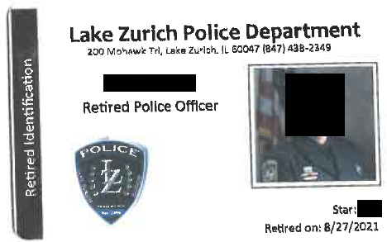
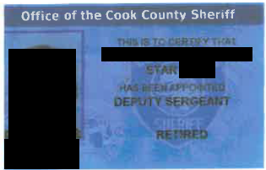
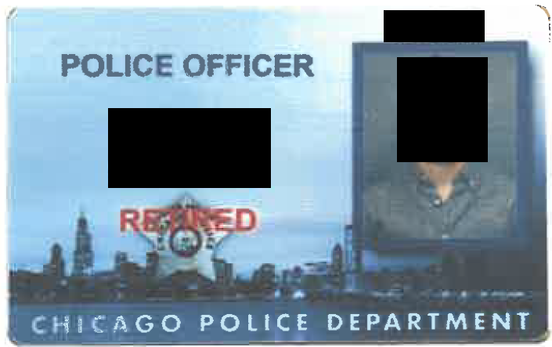
LEOSA – Card Examples
Police or Law Enforcement: No Law Enforcement Reference:

Slide 11
IROCC - Background
To implement the firearm components of LEOSA, the General Assembly passed PA 94-103 in 2006 which:
Set a statewide standard for annual firearm requalification
Gave special authority to the Board to continue training retired law enforcement officers
Allowed the Board to issue certifications to retired law enforcement officers who met the annual firearm requalification training to demonstrate compliance with 4.b of LEOSA
(50 ILCS 705/10.4)
Sec. 10.4. Weapon certification for retired law enforcement officers. The Board may initiate, administer, and conduct annual firearm certification courses consistent with the requirements enumerated in the Peace Officer and Probation Officer Firearm Training Act for retired law enforcement officers qualified under federal law to carry a concealed weapon.

Slide 12
IROCC - Eligibility
Section 1720.220 Definitions
"Qualified Retired Law Enforcement Officer" means an individual who:
1) separated from service in good standing from his or her employing agency (other than for reasons of mental disability);
2) was authorized to perform the specified law enforcement functions and held a position for which powers of arrest were granted by statute;
3) served as a law enforcement officer for an aggregate of 10 years or more before his or her separation in good standing from service with his or her agency, or separated from service in good standing (after completing any applicable probationary period of service) due to a service-connected disability as determined by the agency;
4) has met State firearms training and qualifications that are the same as the training and qualifications for active duty officers;
5) is not under the influence of alcohol or another intoxicating or hallucinatory drug or substance; and
6) is not prohibited by federal law from carrying a firearm.

Slide 13
IROCC – Eligibility (cont.)
Section 1720.240 Eligibility Requirements
A permit to carry a concealed firearm may be issued to a qualified retired law enforcement officer, as defined in Section 1720.220, who:
Before separation from service was a certified law enforcement officer authorized by a local, State, or federal law enforcement department, office, or agency to carry a firearm in the course and scope of his or her duties;
Is in possession of a photographic identification issued by a law enforcement department, office, or agency from which the individual separated in good standing as a law enforcement officer;
Has authorized an investigation to determine if the applicant has been convicted of any disqualifying criminal offenses, and the results of the investigation reveal no findings of guilt for any disqualifying offenses specified in the Act and the FOID Card Act;
Is in possession of a valid FOID Card identifying him or her; and
Is a resident of the State of Illinois.
Any qualified retired law enforcement officer making an application to carry a concealed firearm according to to this Subpart shall, by signing the application form, affirm that he or she meets each of the eligibility requirements described in this Subpart under penalty of perjury.
Note: - "Law Enforcement Officer" means any police officer of a governmental agency who is primarily responsible for the prevention or detection of crime and the enforcement of a criminal code or traffic or highway laws of any state or any political subdivision, and has statutory powers of arrest.

Slide 14
IROCC – Eligibility (cont.)
Section 1720.250 Application Procedure
Any qualified retired law enforcement officer who wishes to apply for a permit under this Part may request an application in writing or by telephone from the Illinois Retired Officer Concealed Carry Program, P.O. Box 9860, Springfield, Illinois 62791, (217)726-9537 or online at www.ptb.state.il.us. The Board shall develop the application forms and necessary procedures to implement this program.
The completed application shall include a certification that it constitutes a sworn affidavit signed by the applicant attesting to compliance with the eligibility requirements.
An applicant must provide evidence of photographic identification issued by his or her prior local, State, or federal law enforcement employer verifying the status of the applicant as having been separated from service in good standing.
All information on the application or any related document must be complete and accurate to the best of the applicant's knowledge. Failure to provide the information necessary to complete the application shall preclude any further processing and shall result in the denial of the application.
An applicant shall pay a $75 (when seeking certification and permit to carry either a revolver or a semi-automatic pistol) or $100 (when seeking certification and permit to carry both a revolver and a semi-automatic pistol) non-refundable fee at the time the initial application is filed…
An applicant must provide evidence of possession of a valid FOID Card at the time of application.
Written notification of approval or denial of an application shall be sent within 60 working days after receipt of a completed application by the Board unless additional information is needed. Approved applications shall include additional information regarding the availability of ranges and requirements for the Certification Program. Failure of the Board to issue a written notification on an application within the 60 working day period shall not be deemed an approval of the application by the Board.

Slide 15
IROCC – Eligibility: Summary
To participate in the IROCC program, an individual must:
Meet all LEOSA qualifications
Provide a copy of the ID card required by LEOSA
Be a certified law enforcement officer
Have been authorized to carry a firearm in the course of their duties before retirement
Be free from any decertifiable offenses
Have a valid FOID card
Submit a sworn affidavit attesting to compliance with the eligibility requirements of LEOSA and the Board’s Administrative Rules
Be a resident of Illinois

Slide 16
IROCC: Challenges
Moore v. Trent: No private right of action to compel an employer to issue a LEOSA card. 09 C 1712 (N.D. Ill. Dec. 16, 2010).
Foley v. Godinez: State agency director (IDOC) had the discretion to deny requests for LEOSA cards even if the eligibility components may be met. 62 N.E.3d 286, 2016 Ill. App. 151814 (4th Dist. 2016).
Henrichs v. ILETSB: There is no constitutional right to LEOSA privileges – specifically rejecting the holding of DuBerry. 306 F. Supp. 3d 1049 (N.D. Ill. 2018).

Slide 17
HB 4667 – PA 102-779
In April of 2022, an amendment was filed to HB 4667 which replaced everything in the existing bill with new language that:
Added state and county correctional officers to the existing exception for law enforcement officers regarding certain crimes related to firearm possession if they are qualified under the laws of this state or LEOSA.
Amended the County Jail Act to specifically declare that county correctional officers shall be deemed “qualified active or retired law enforcement officers” for LEOSA purposes and they shall have LEOSA privileges if the officer is otherwise compliant with the laws of Illinois governing the implementation of LEOSA.
Amended the Illinois Code of Corrections with a similar provision for IDOC correctional officers.

Slide 18
HB 4667 - Purpose
To encourage individuals to seek careers as correctional officers by making the position more attractive with the ability to seek secondary employment as “peace officers” allowed to carry firearms off-duty under LEOSA
But HB 4667 did not:
Grant correctional officers arrest powers
Declare correctional officers to be “peace officers”
Place any mandates on ILETSB
Change any definitions in the Police Training Act
Require corrections officers to comply with the Peace Officer and Probation Officer Firearm Training Act

Slide 19
HB 4667 - Concerns
Major difference in training for correctional officers – specifically in the area of public interactions when armed
No training or certification requirement for part-time correctional officers
There is no annual firearm requalification requirement for correctional officers
Correctional officers with felonies or decertifiable offenses in their history had more privileges than similarly situated law enforcement officers.
LEOSA complications
Not “law enforcement” under state definitions
No statutory powers of arrest
No card from the employer indicating police or law enforcement officer status
No firearm qualification in the year proceeding retirement

Slide 20
HB 4667 - Response
Upon learning that the intent was also to address firearm privileges in retirement, ILETSB staff:
Requested an amendment from LRB with our suggestions
Reached out to House and Senate staff to express concerns and discuss a possible amendment
Requested meetings with the sponsors to continue working on the issue over the summer
Engaged in conversations with IDOC, representatives from the Governor’s Office, and Lt. Governor’s legislative team to discuss amendatory veto options
Discussed alternative avenues to achieve the intended objectives with House and Senate staff
Requested an interpretive opinion and guidance from the Attorney General’s Office

Slide 21
HB 4667 – Next Steps
We have prepared a bill that:
Offers a special concealed carry privilege to correctional officers
Allows the Board to conduct special training for correctional officers seeking to carry off-duty
Establishes a certification and training requirement for part-time correctional officers
Establishes an in-service training requirement for correctional officers
Allows for decertification of correctional officers in the same manner as law enforcement officers

Slide 22
Summary:
LEOSA is a federal provision that allows individuals to carry a firearm across state lines if they:
Served for at least 10 years as a law enforcement officer
Had statutory powers of arrest
Separated in good standing, and
Have a card that indicates they met the state firearm qualification in the last year
IROCC is a program that assists those who qualify for LEOSA by facilitating the state firearm qualification.
To be eligible for IROCC:
Must meet all LEOSA qualifications
Must be a certified law enforcement officer
Must have met state firearm qualifications while employed, and
Must be a resident of Illinois with a valid FOID card

Slide 23
CONCLUSION:
We understand the concerns of correctional officers and will consider any possible avenue to meet the intentions of HB 4667.
We believe that a more detailed solution can be considered that addresses the concerns of several interested stakeholder groups that can be implemented by ILETSB using existing tools.
We recognize that the law on this issue continues to evolve with new case holdings and legislative amendments - we will comply accordingly when provided with statutory authority and direction.

